Slide 1
General Linear Regression

Slide 2
Learning Objectives
Describe the Linear Regression Model
State the Regression Modeling Steps
Explain Ordinary Least Squares
Compute Regression Coefficients
Understand and check model assumptions
Predict Response Variable

Slide 3

Models
What is a Model?
Representation of Some Phenomenon
Non-Math/Stats Model

Slide 4
What is a Math/Stats Model?
Often Describe Relationship between Variables
Types
Deterministic Models (no randomness)
Probabilistic Models (with randomness)
Deterministic Models
Hypothesize Exact Relationships
Suitable When Prediction Error is Negligible
Example: Body mass index (BMI) is measure of body fat based
Weight in Kilograms (Height in Meters)²
Metric Formula: BMI =
Weight (pounds)x703 (Height in inches)²
Non-metric Formula: BMI =

Slide 5
Probabilistic Models
1. Hypothesize 2 Components
Deterministic
Random Error
Example: Systolic blood pressure of newborns Is 6 Times the Age in days + Random Error
SBP = 6xage(d) + ε
Random Error May Be Due to Factors Other Than age in days (e.g. Birthweight)

Slide 6
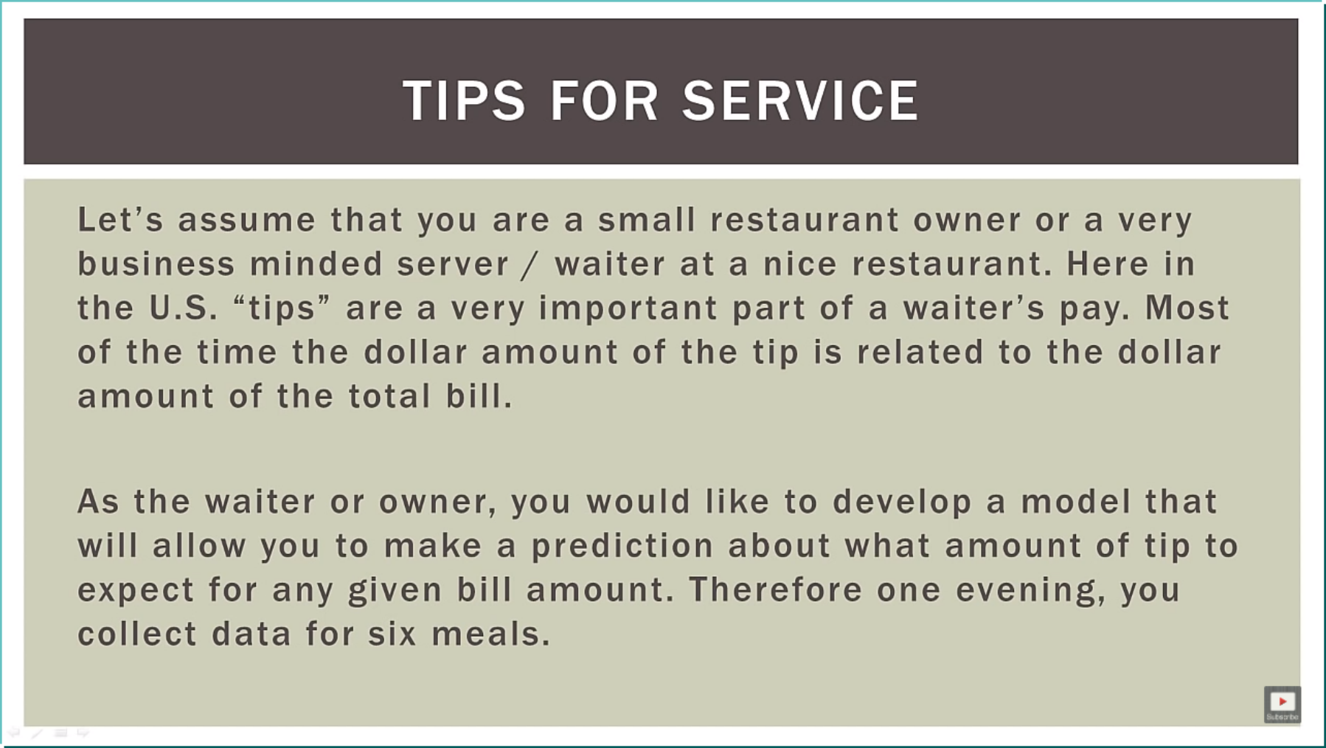
Let’s Look at a problem

Slide 7
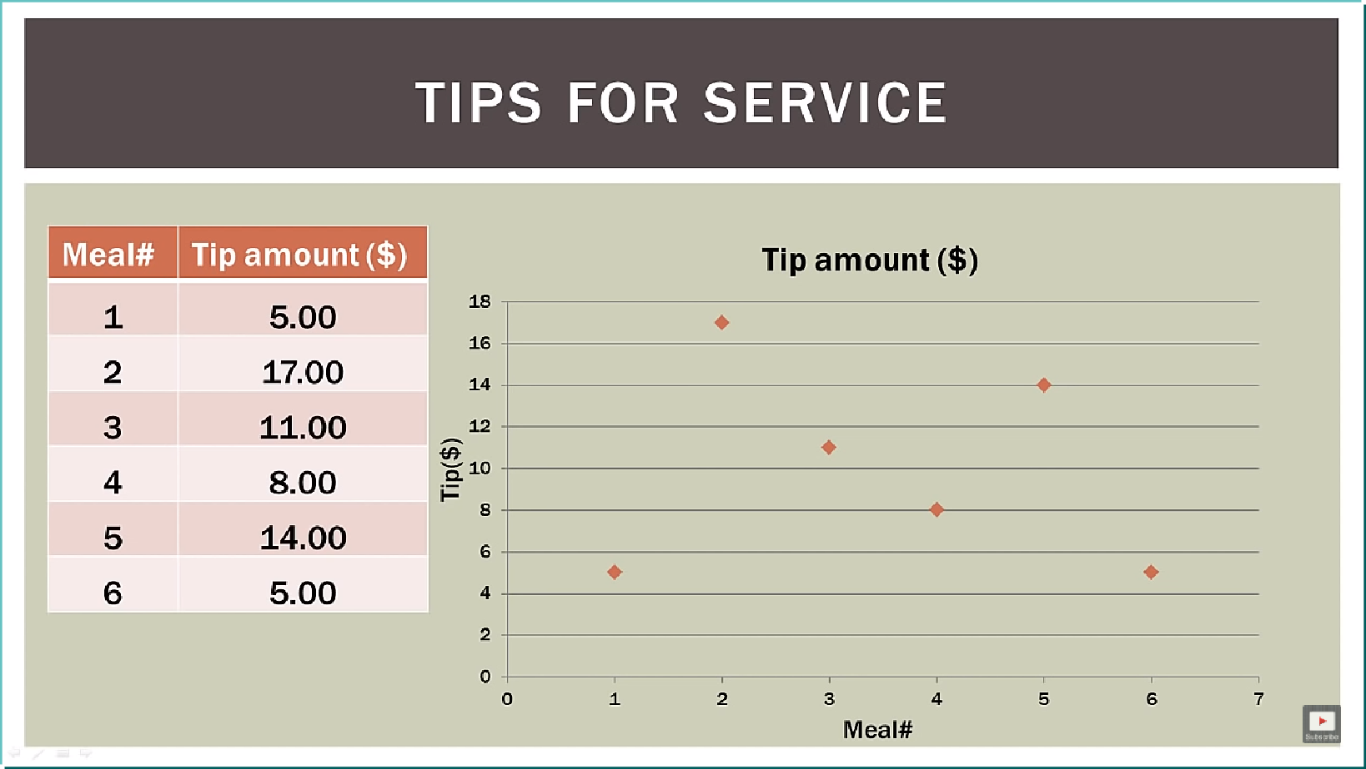
Regression Model
Relationship between one dependent variable and explanatory variable(s)
Use equation to set up relationship
Numerical Dependent (Response) Variable
1 or More Numerical or Categorical Independent (Explanatory) Variables
Used Mainly for Prediction & Estimation
Let’s look at the tips…

Slide 8
Regression Modelling Steps
1. Hypothesize Deterministic Component
Estimate Unknown Parameters
2. Specify Probability Distribution of Random Error Term
Estimate Standard Deviation of Error
3. Evaluate the fitted Model
4. Use Model for Prediction & Estimation

Slide 9
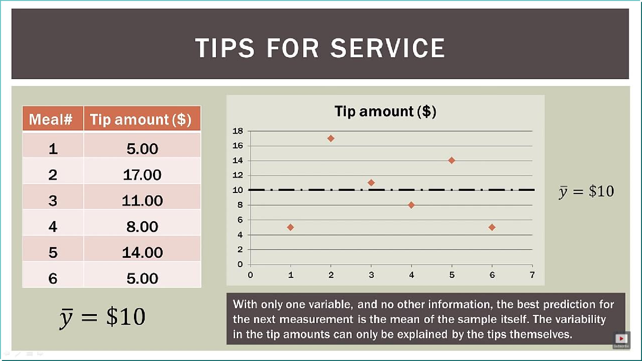
What could be a estimate….

Slide 10
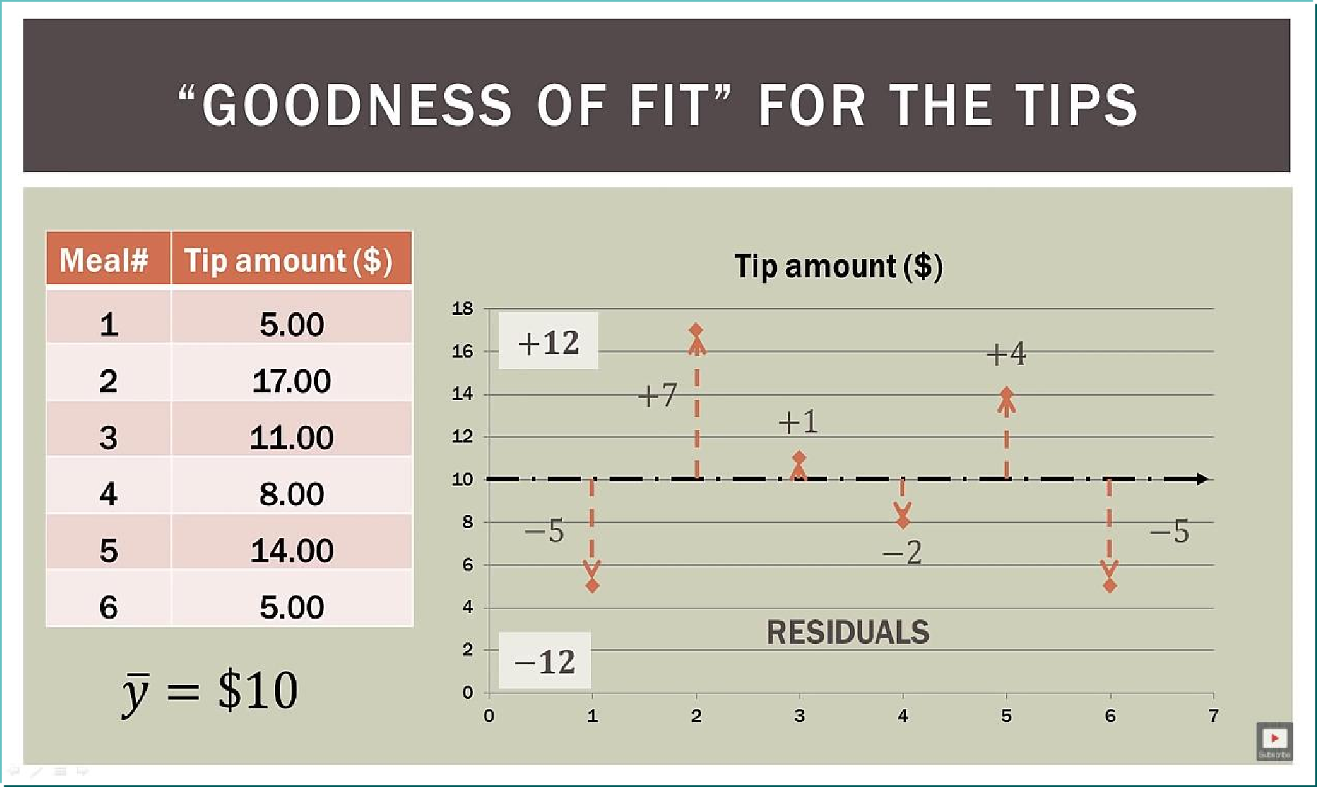
Model Specification
Goodness of Estimate….

Slide 11
Specifying the deterministic component
Define the dependent variable and independent variable
Hypothesize Nature of Relationship
Expected Effects (i.e., Coefficients’ Signs)
Functional Form (Linear or Non-Linear)
Interactions

Slide 12
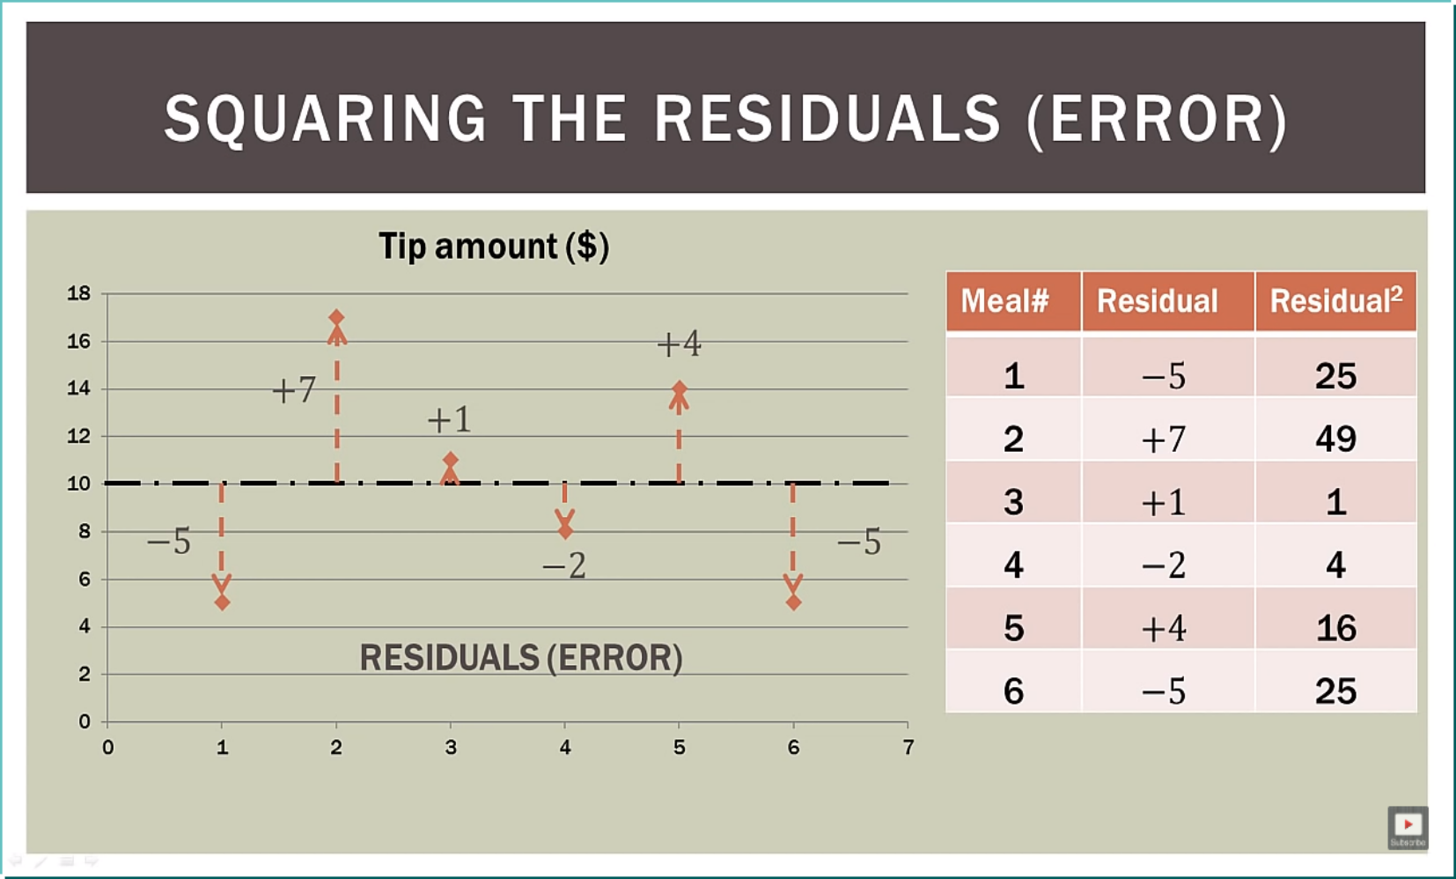
Square of Residuals..

Slide 13
Linear Regression Model

Slide 14
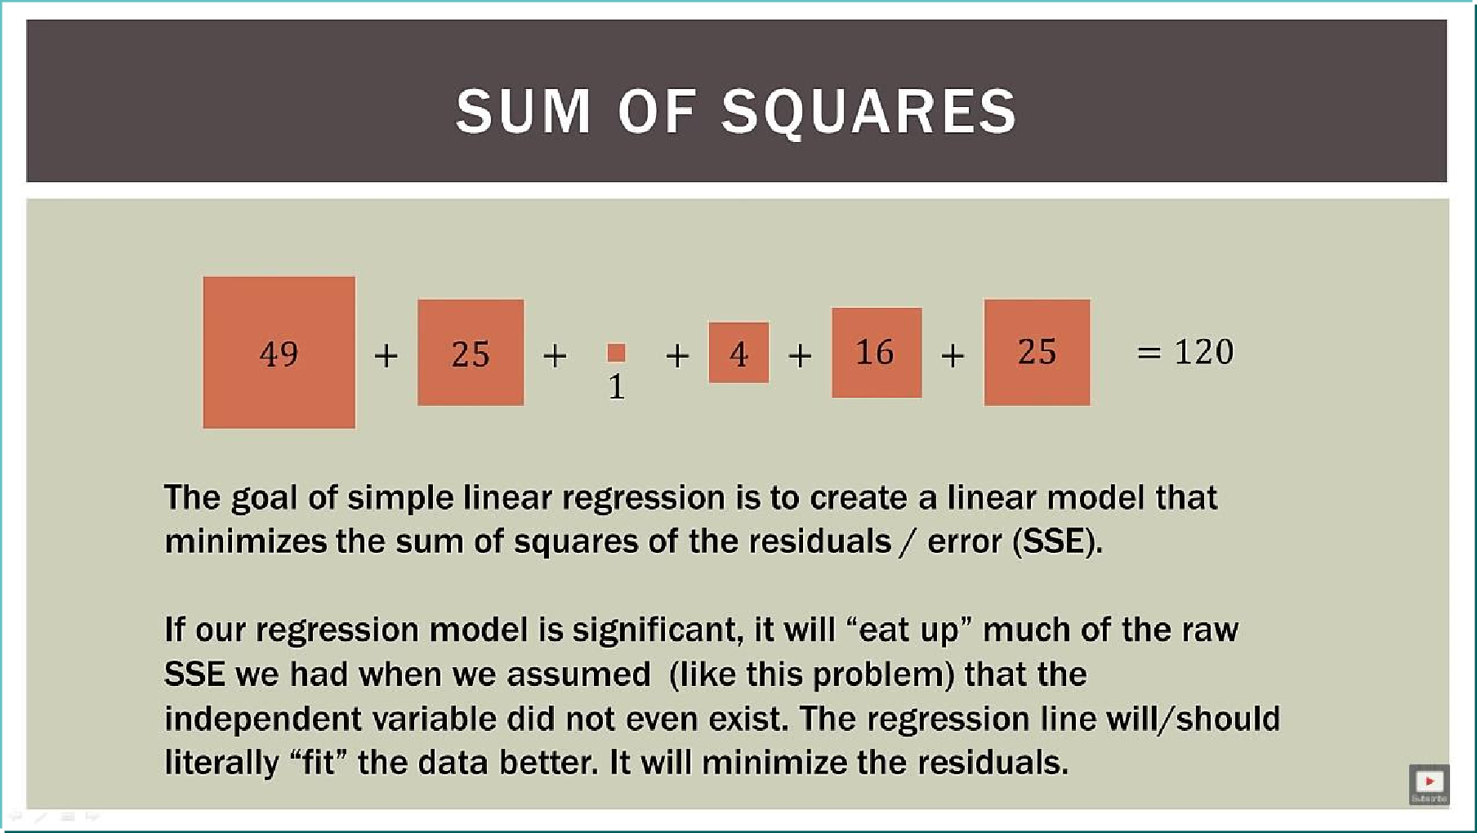
Minimise the error

Slide 15
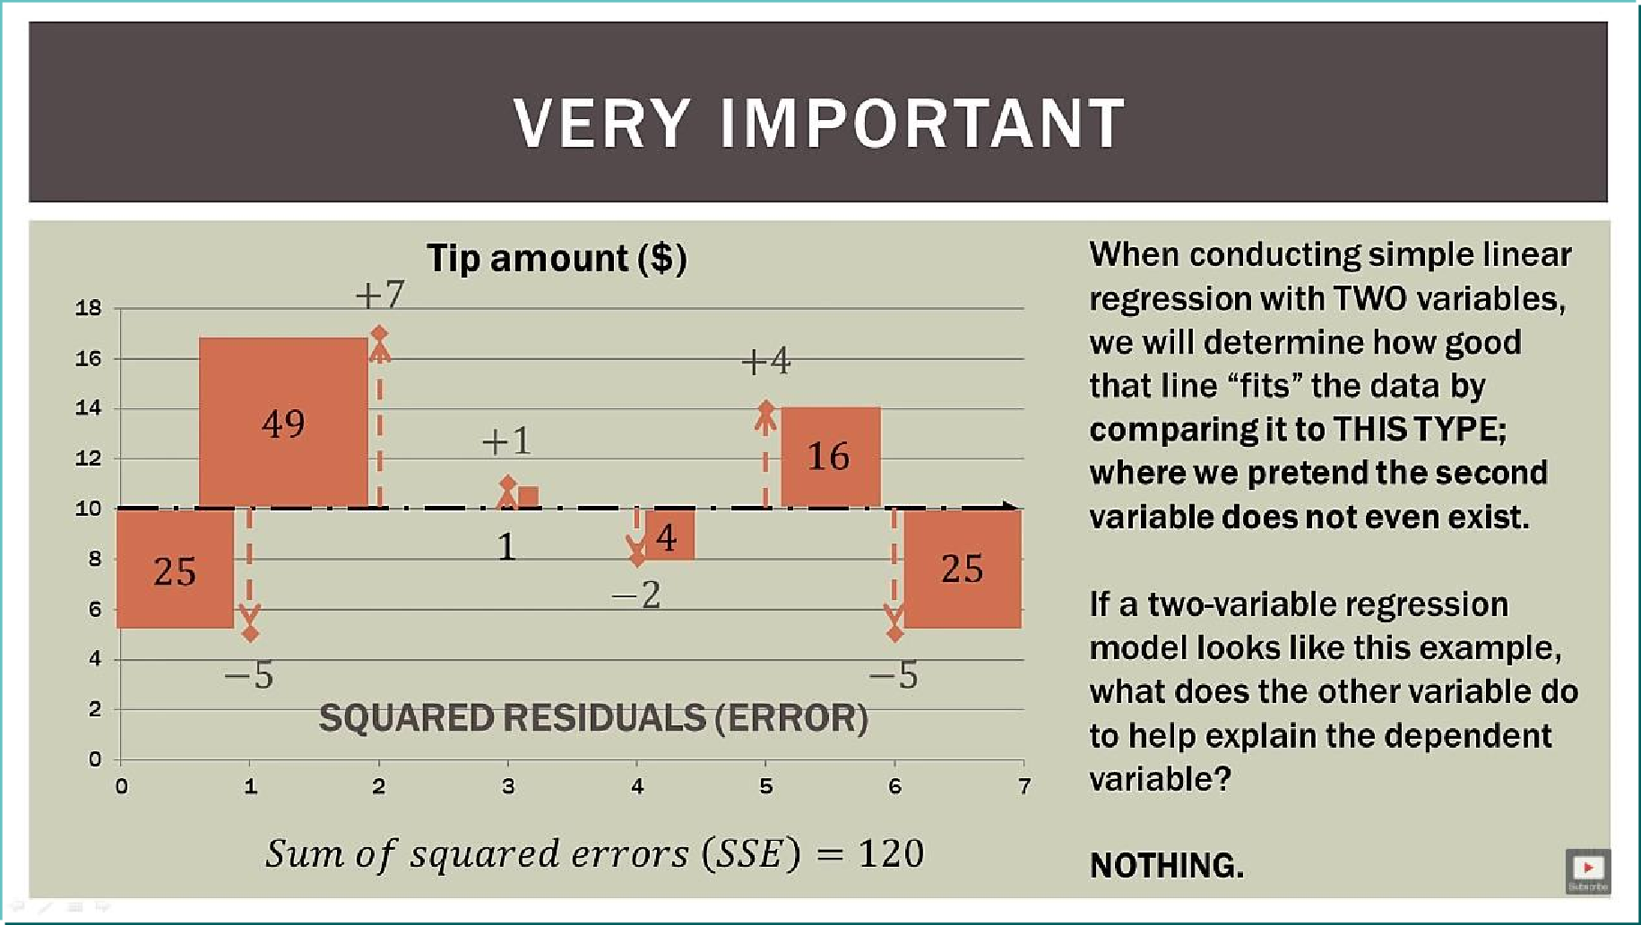
Introduction of new Variable

Slide 16
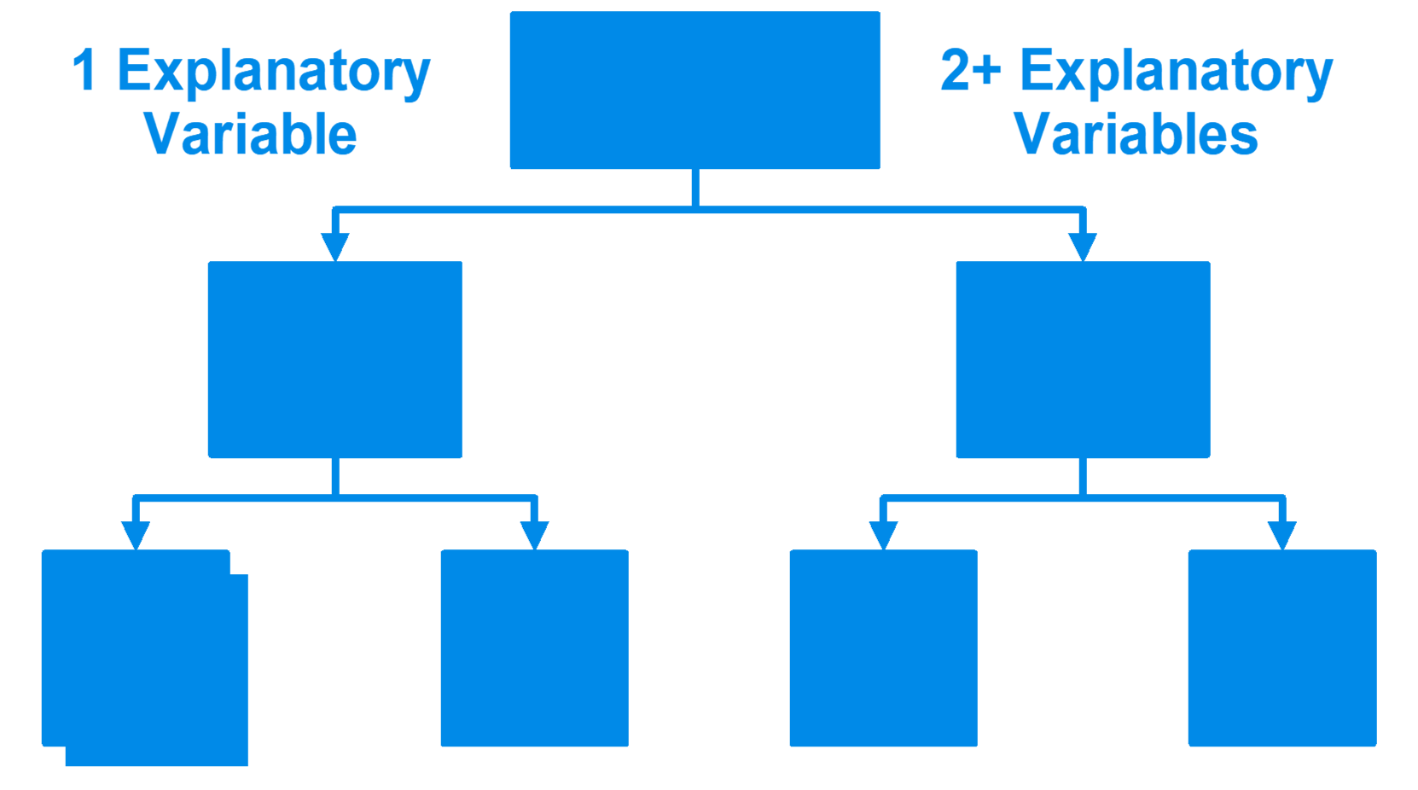
Introduction of new Variable
Regression Models
Simple
Multiple
Non- Linear
Linear
Non- Linear
Linear

Slide 17
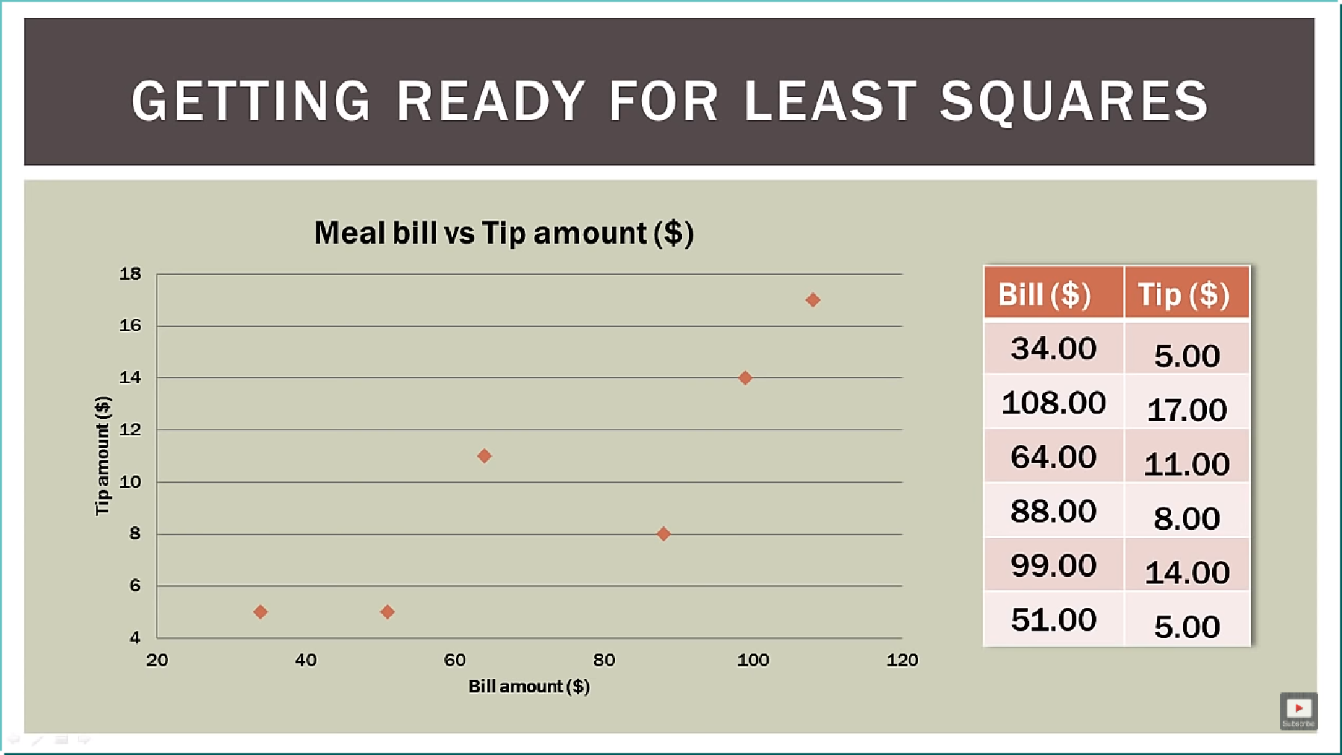
New Variable

Slide 18
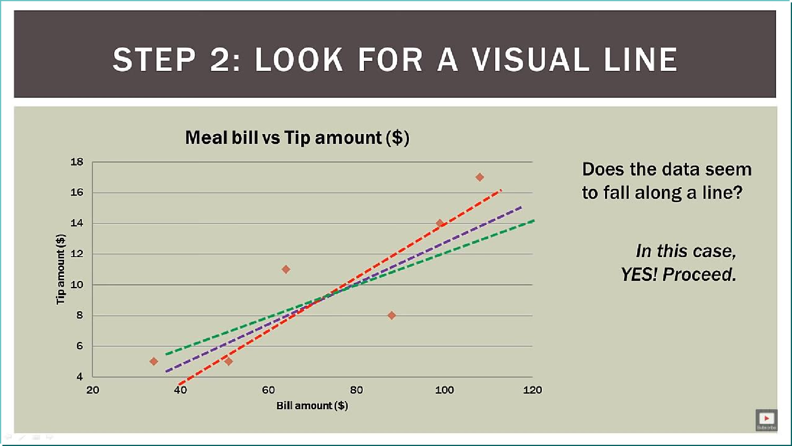
Does it represent a line ?

Slide 19
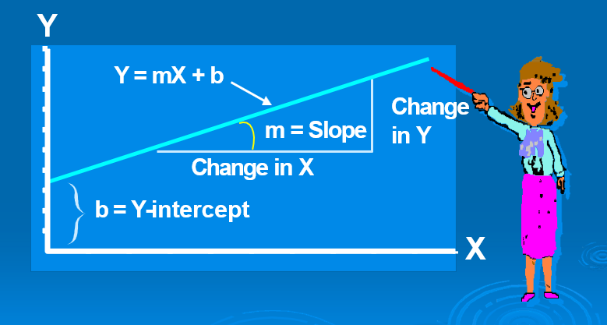
Linear Equations

Slide 20


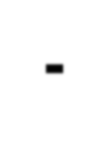


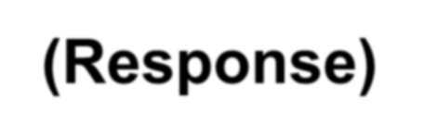
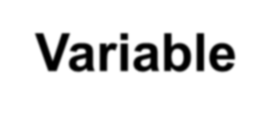
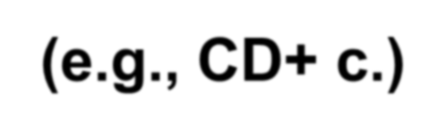
Linear Regression Model
Relationship Between Variables Is a Linear Function
Population Slope
Random Error
Y_{i} = β₀
+ β₁X_{i} + ε_{i}
Independent (Explanatory) Variable (e.g., Years s. serocon.)

Slide 21
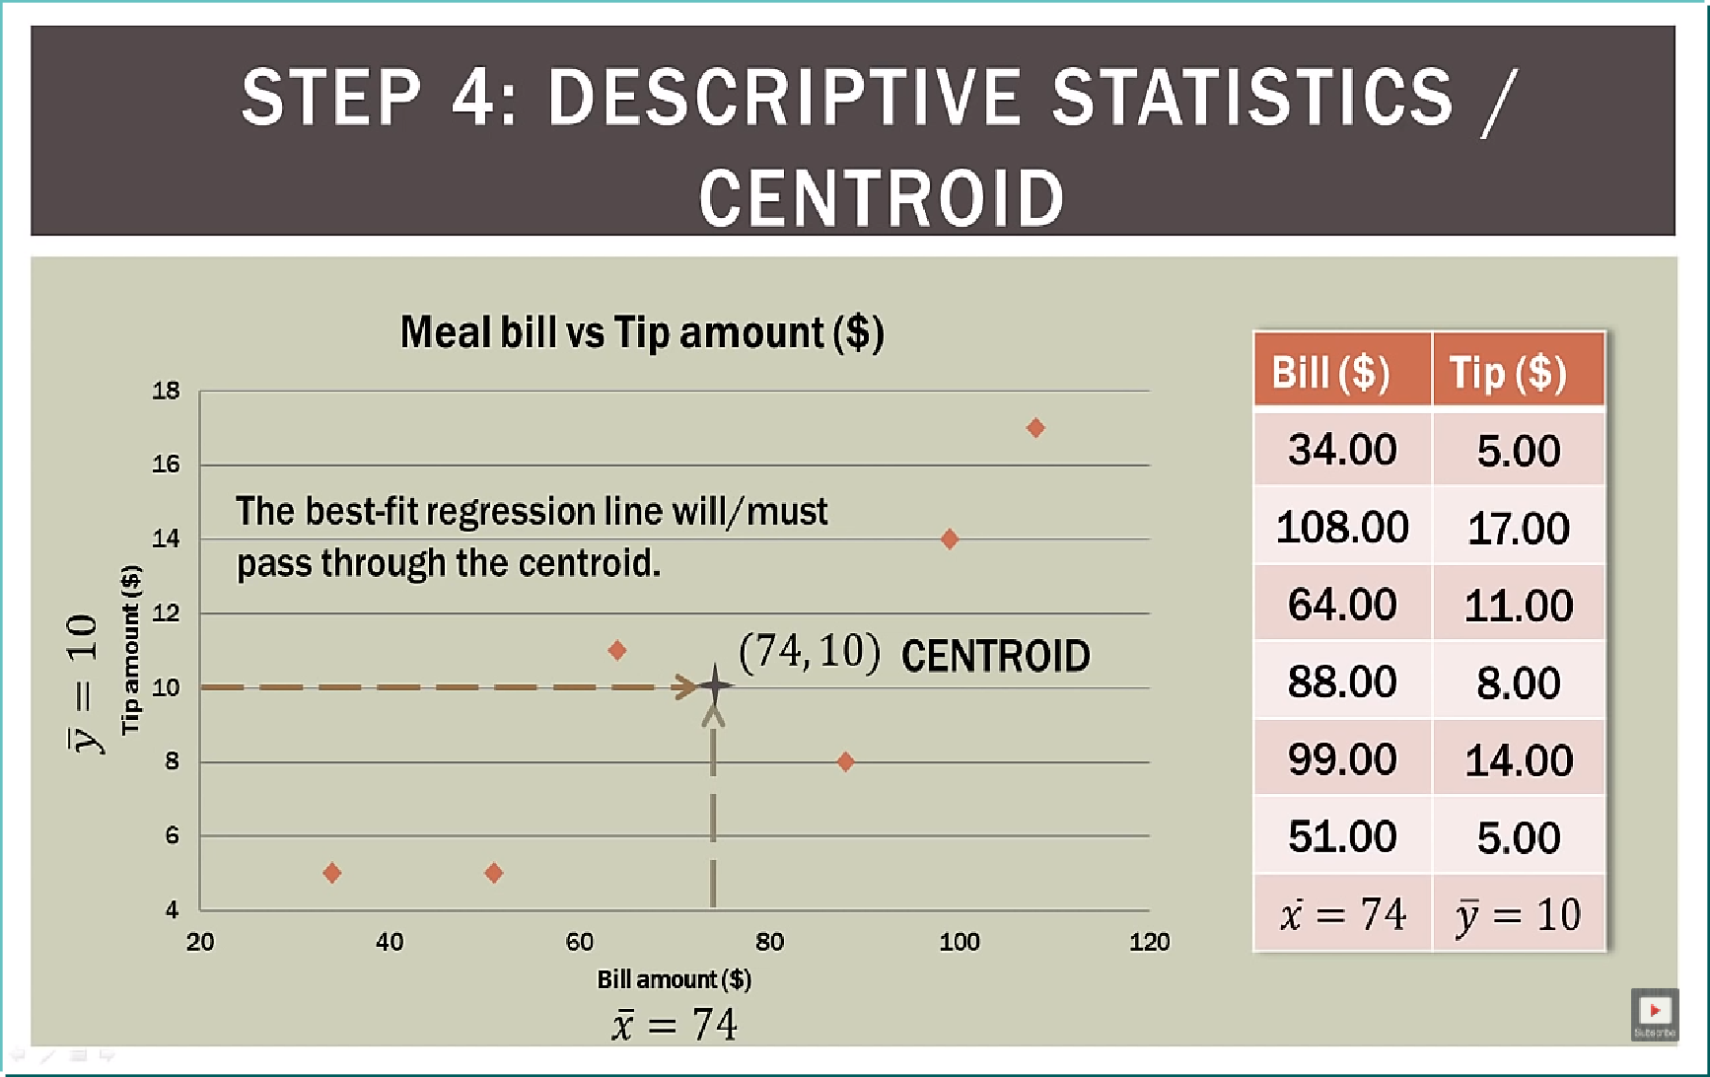
Does it represent a line ?

Slide 22
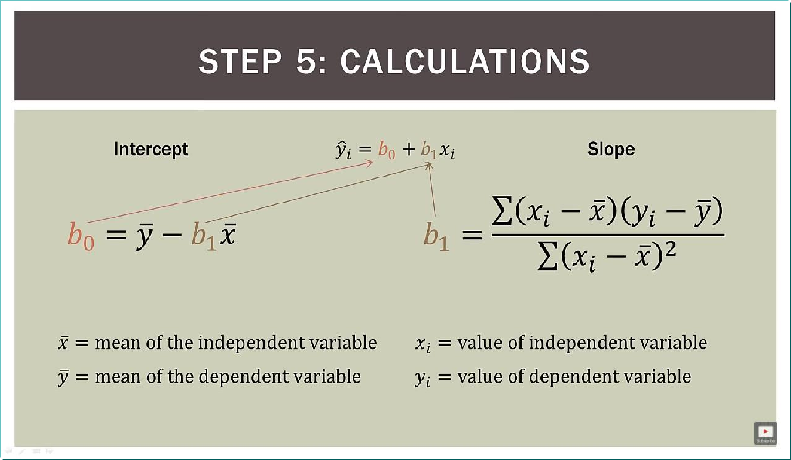
Components of the line…

Slide 23
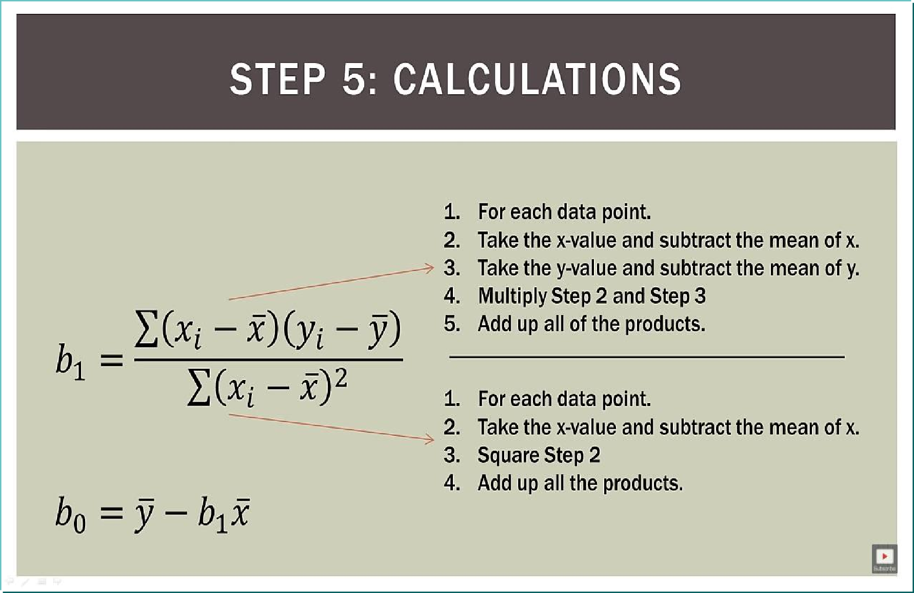
Process to calculate

Slide 24
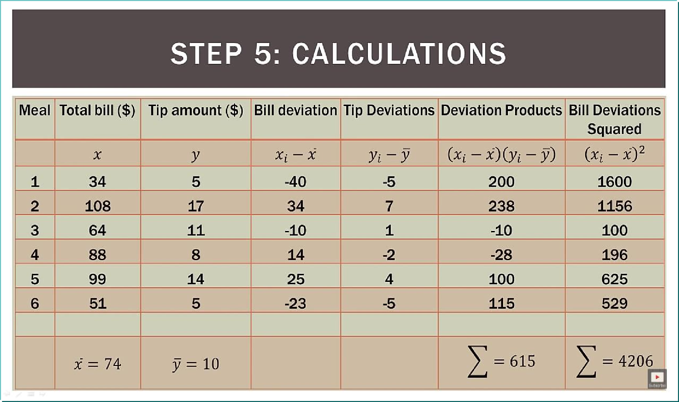
Tabulation Process

Slide 25
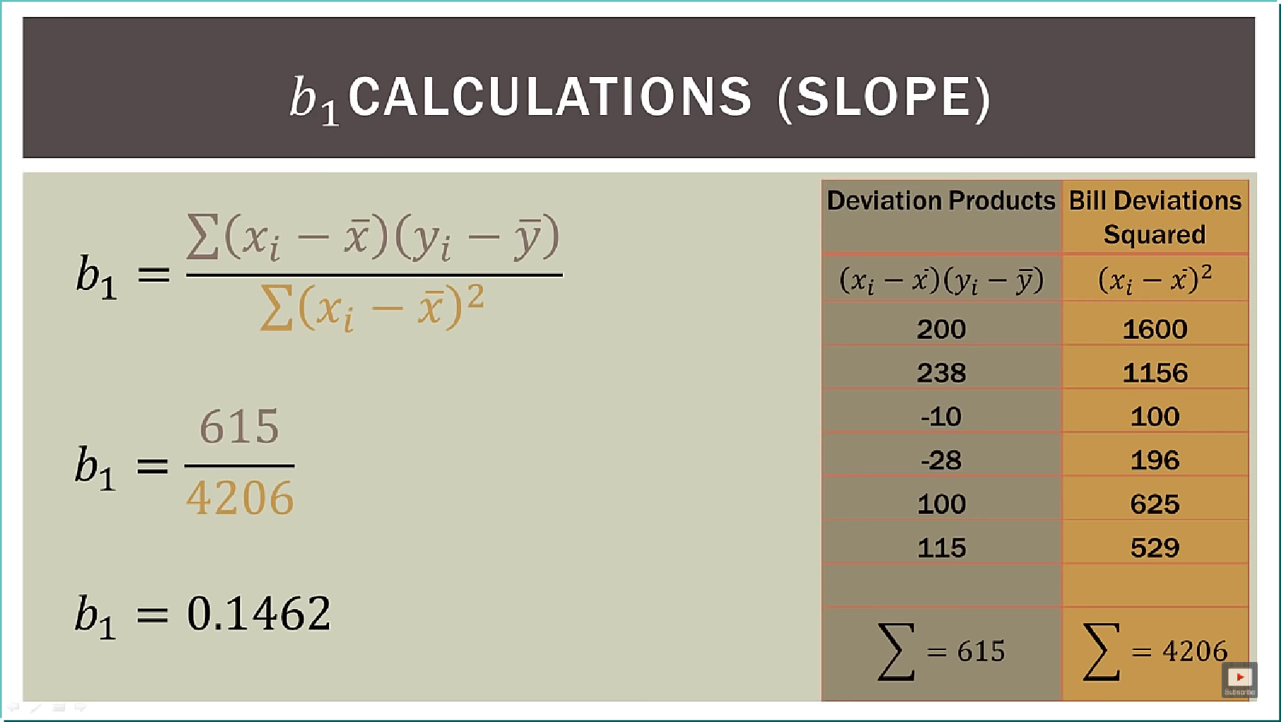


Calculation of Slope….

Slide 26
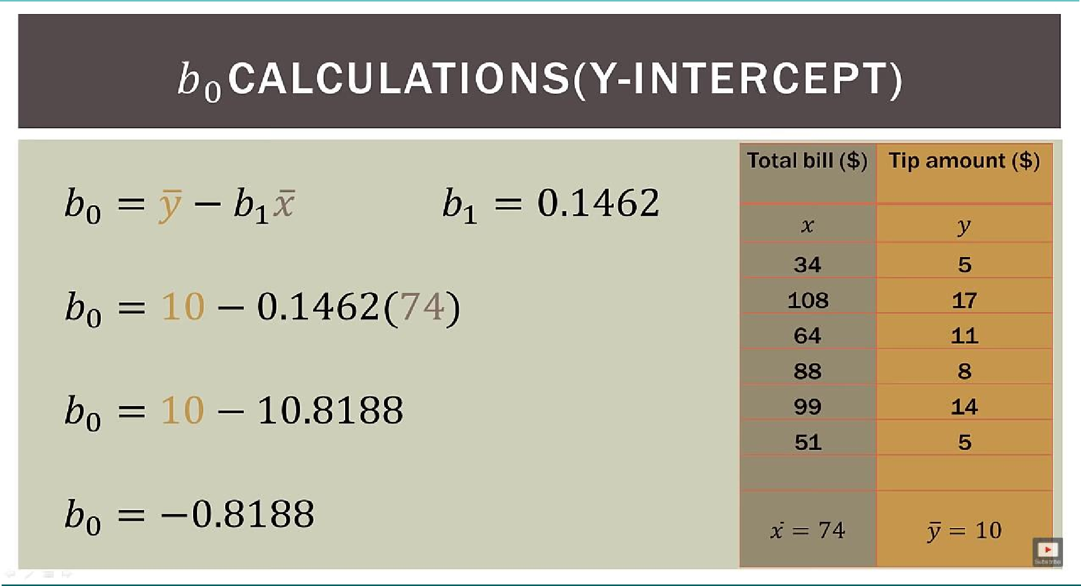
Calculation of Intercept

Slide 27
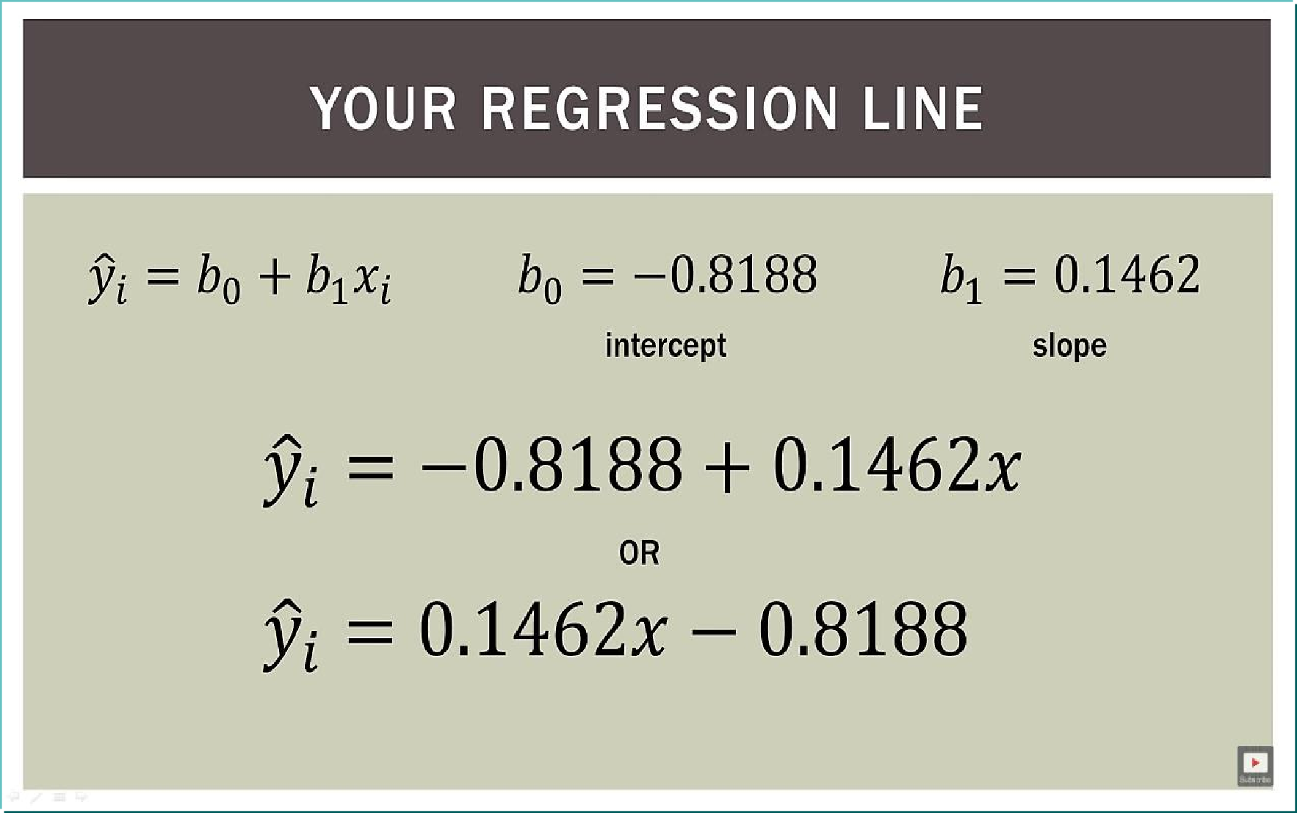
Voila….The st. Line Eq

Slide 28
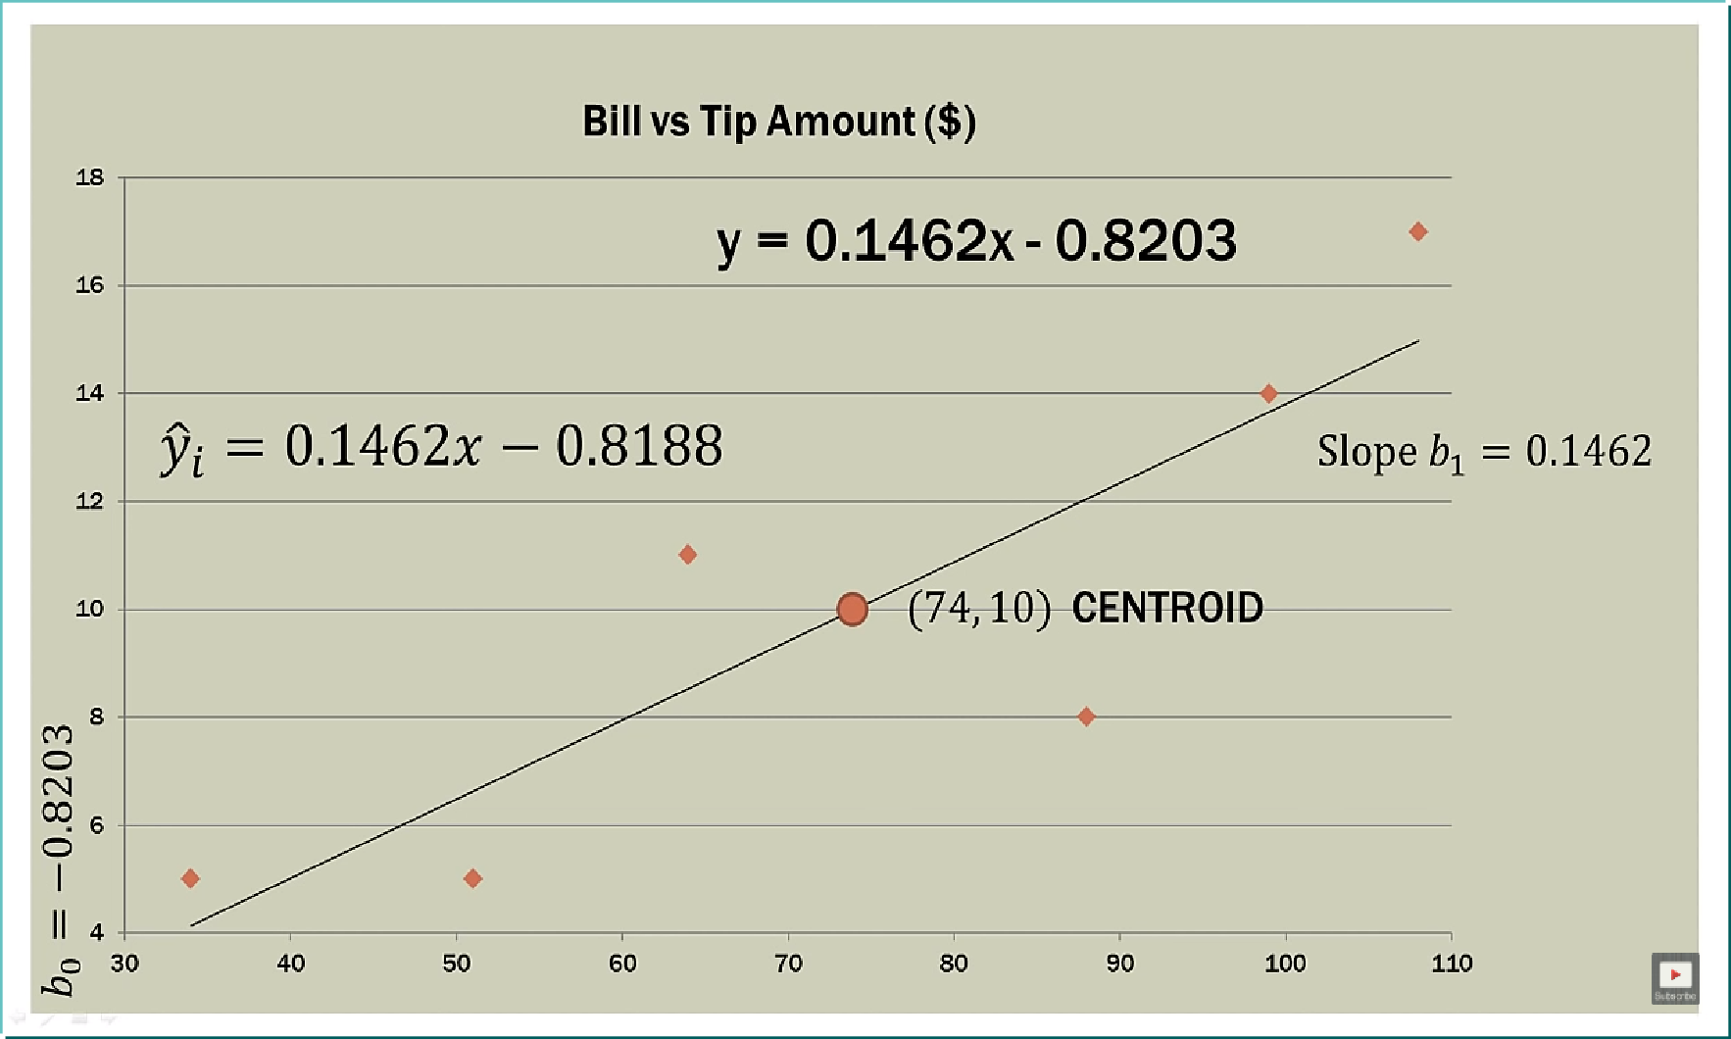
Graphical Representation of our model

Slide 29
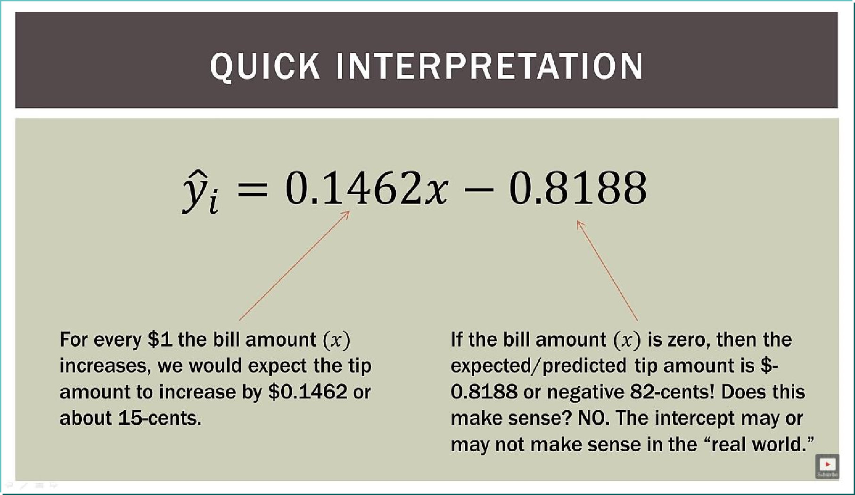
Making Sense of it….

Slide 30
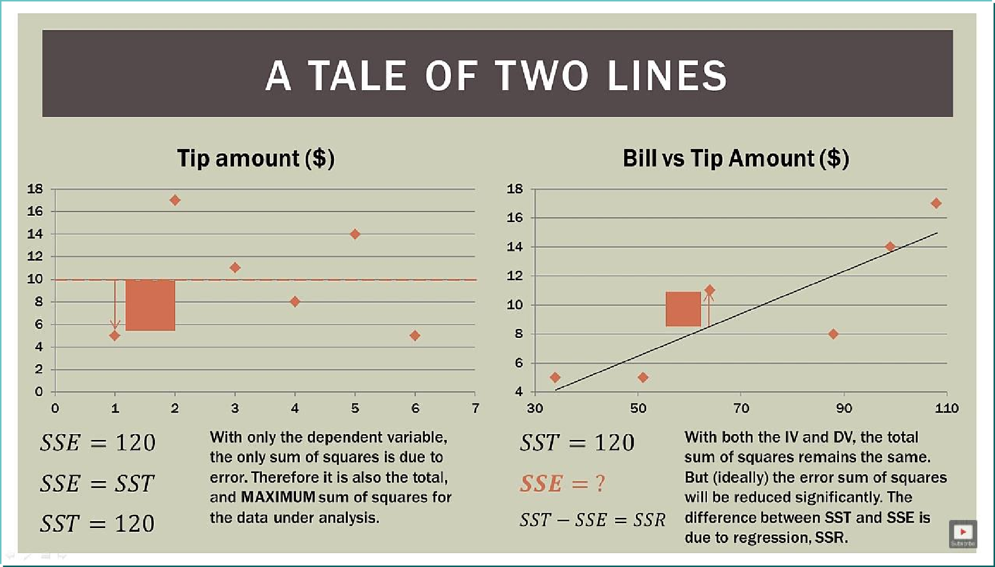
Is Our Model Better?

Slide 31
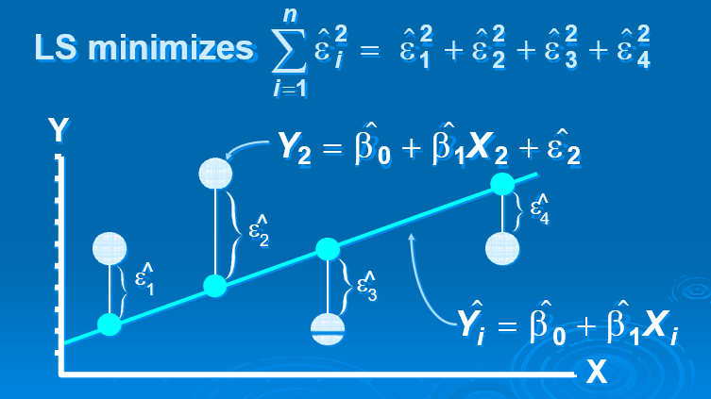
Least Squares Graphically

Slide 32
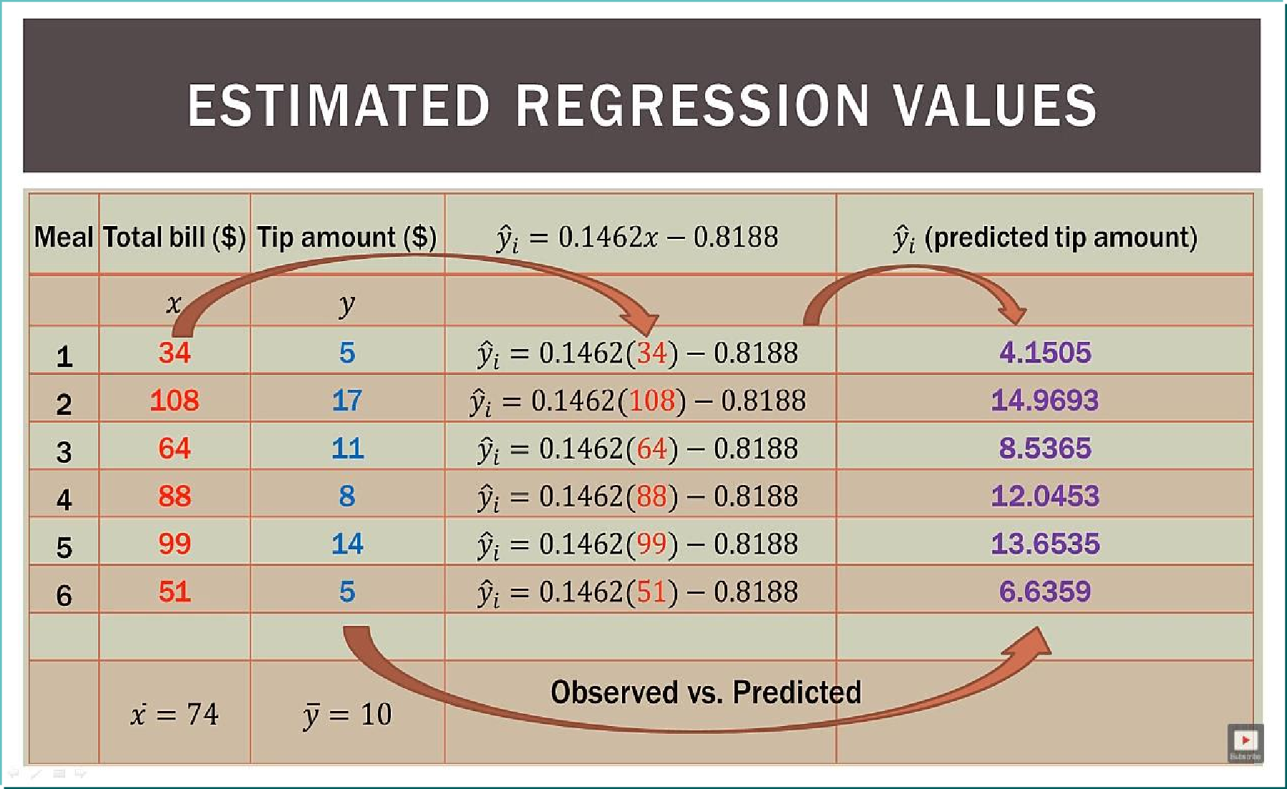
Error = Observed - Predicted

Slide 33
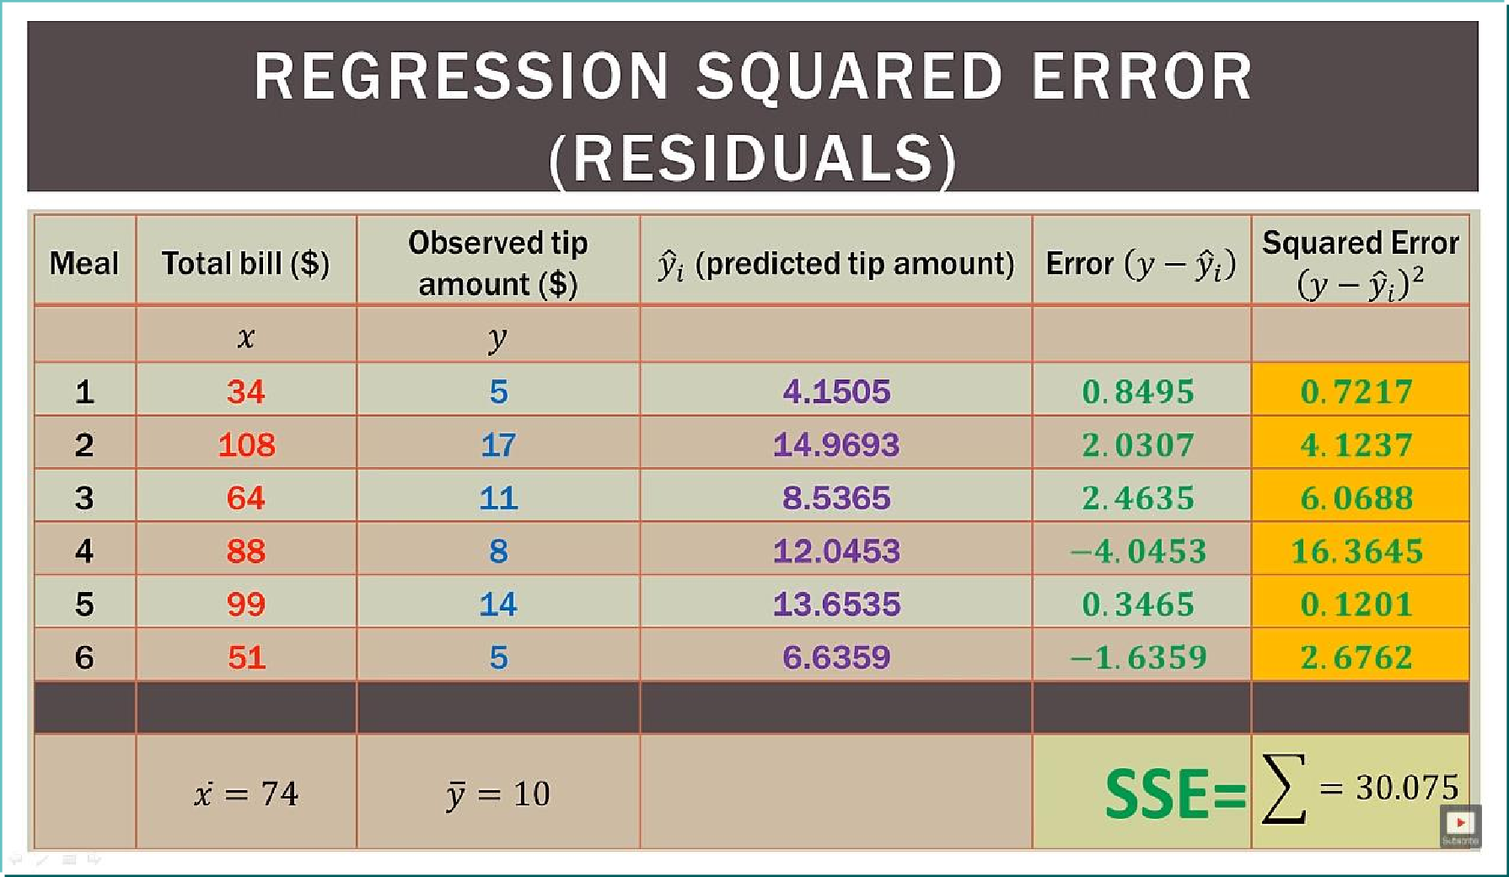
The Squared Error

Slide 34
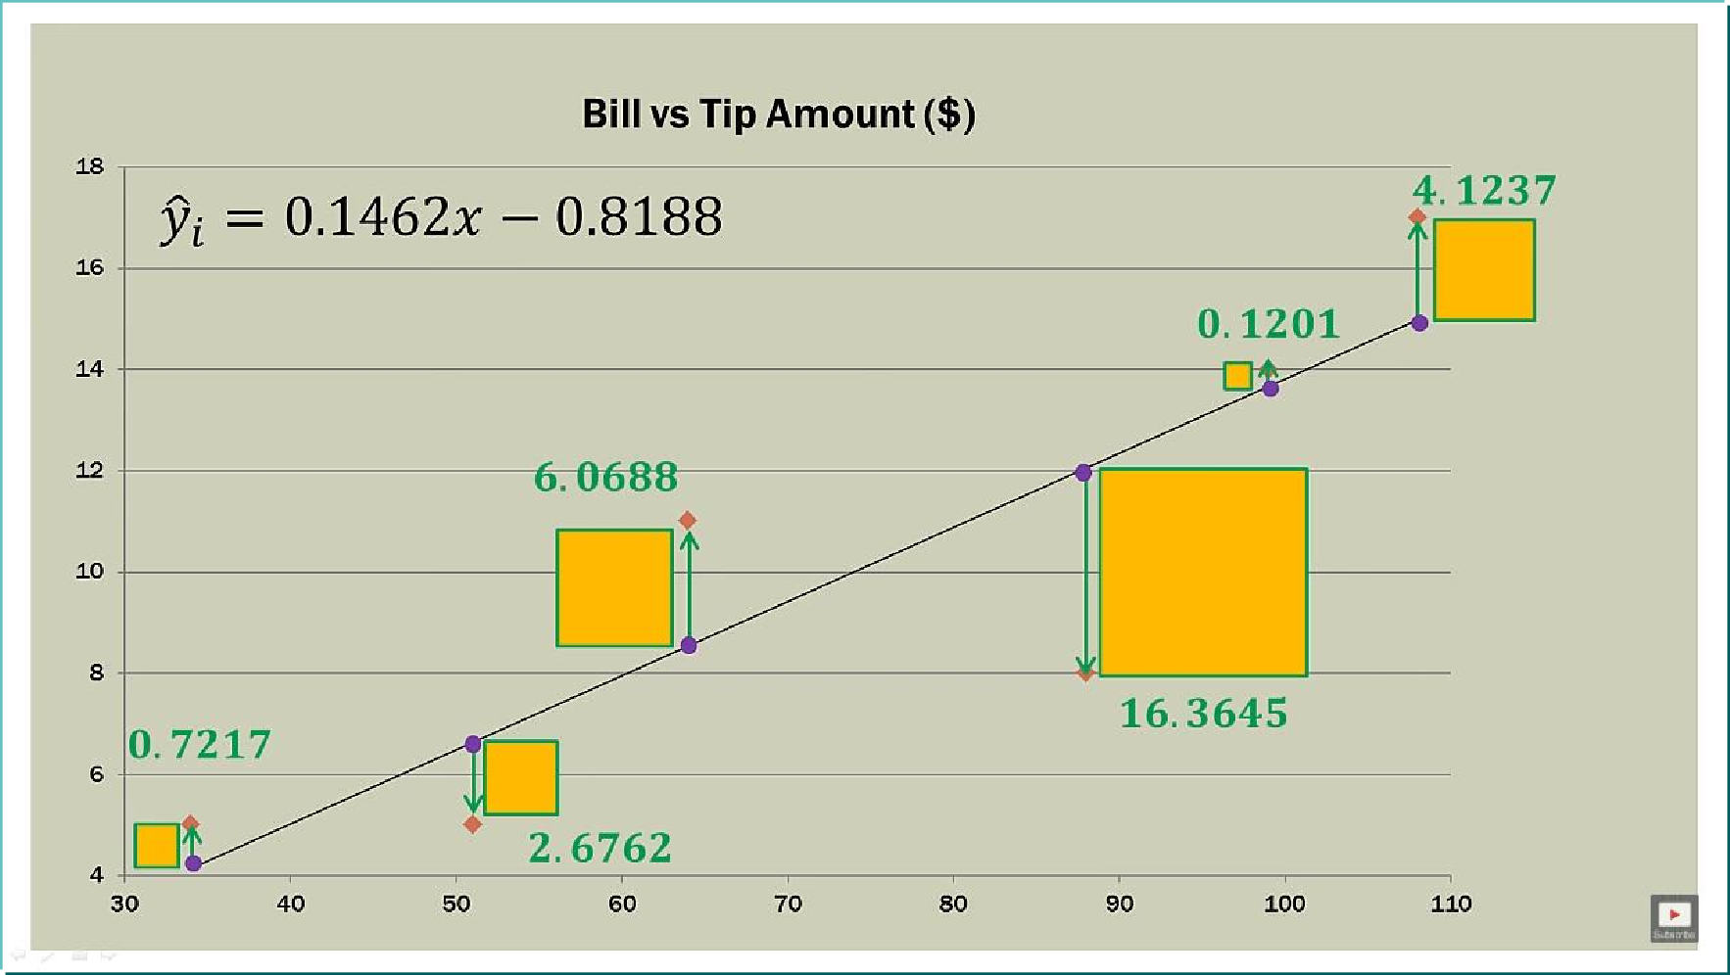
On The Graph….

Slide 35
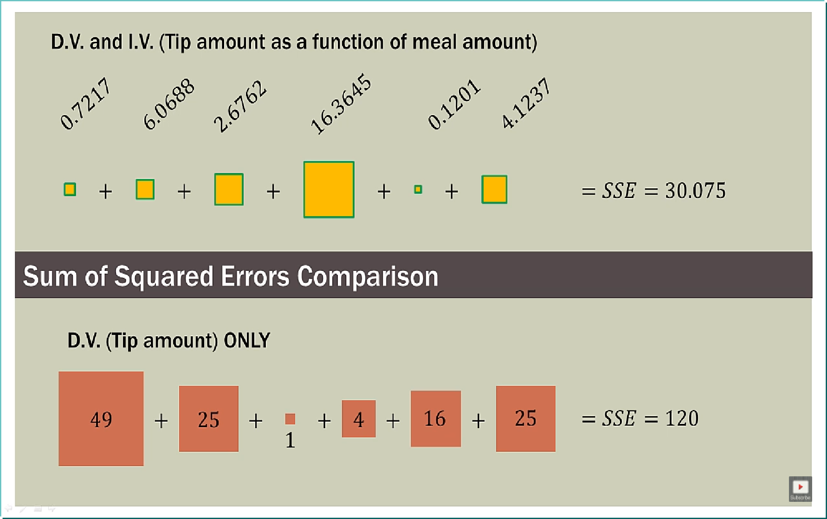
Did The Error Decrease...

Slide 36
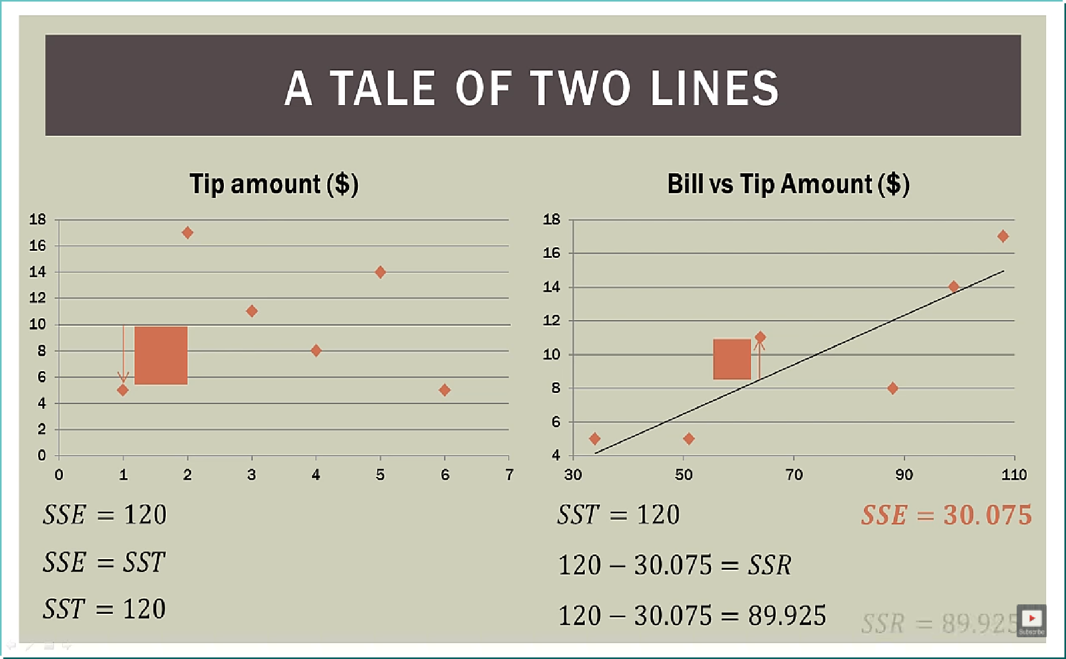
Visual representation…

Slide 37
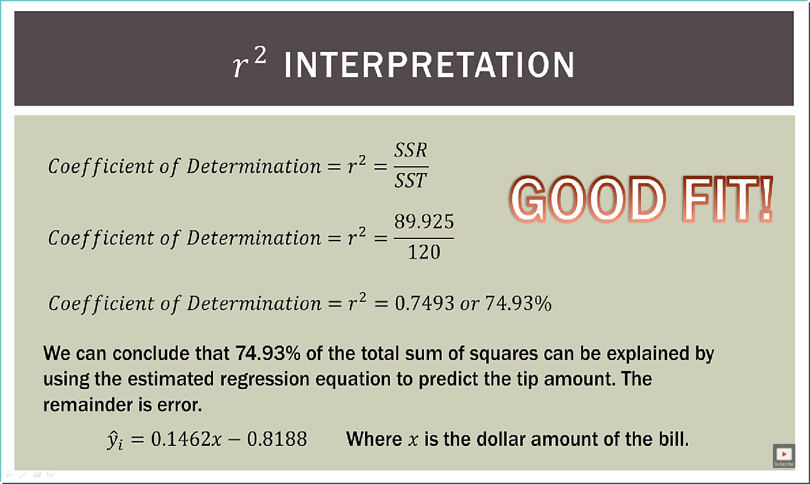
Explanation of errors…

Slide 38
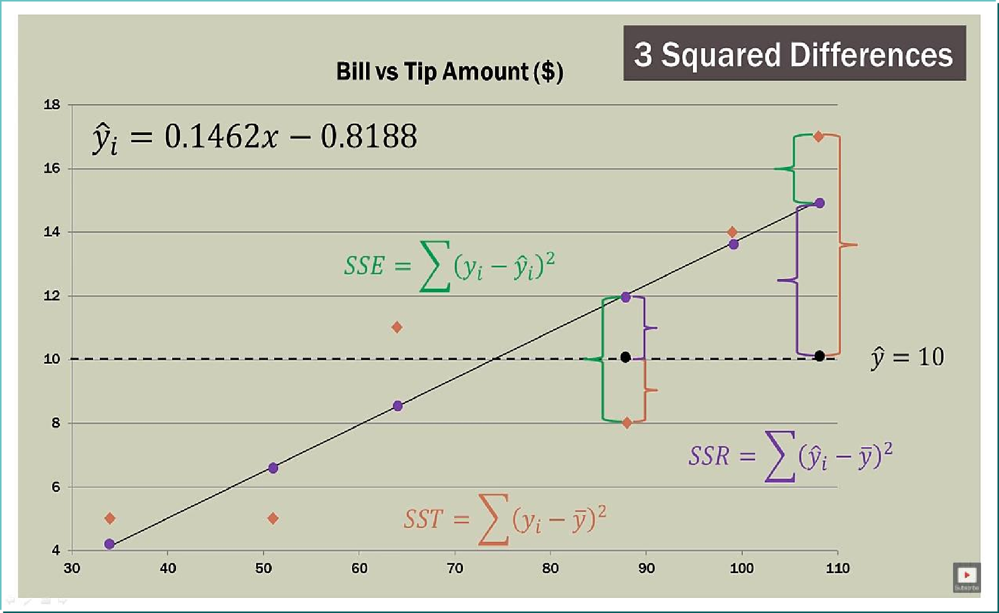
SST = SSE+SSR

Slide 39
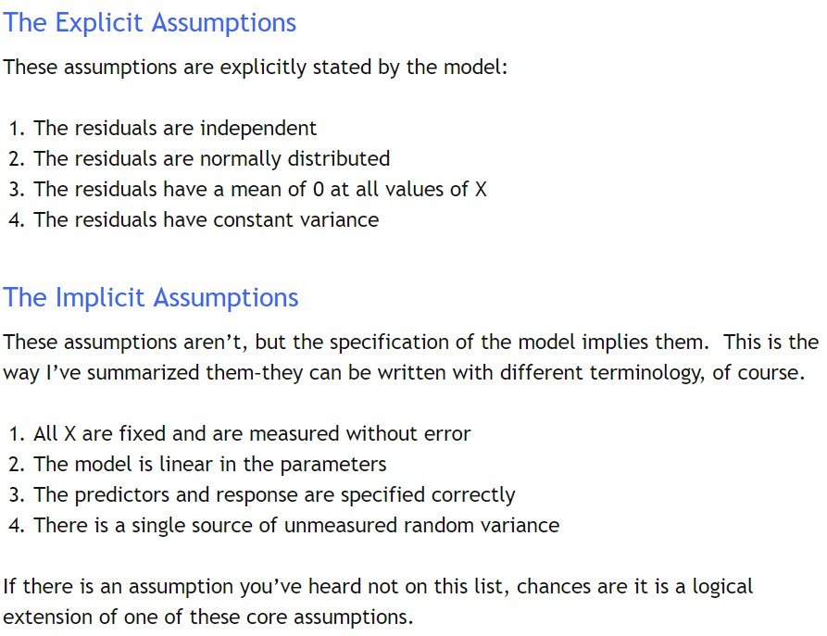

Slide 40
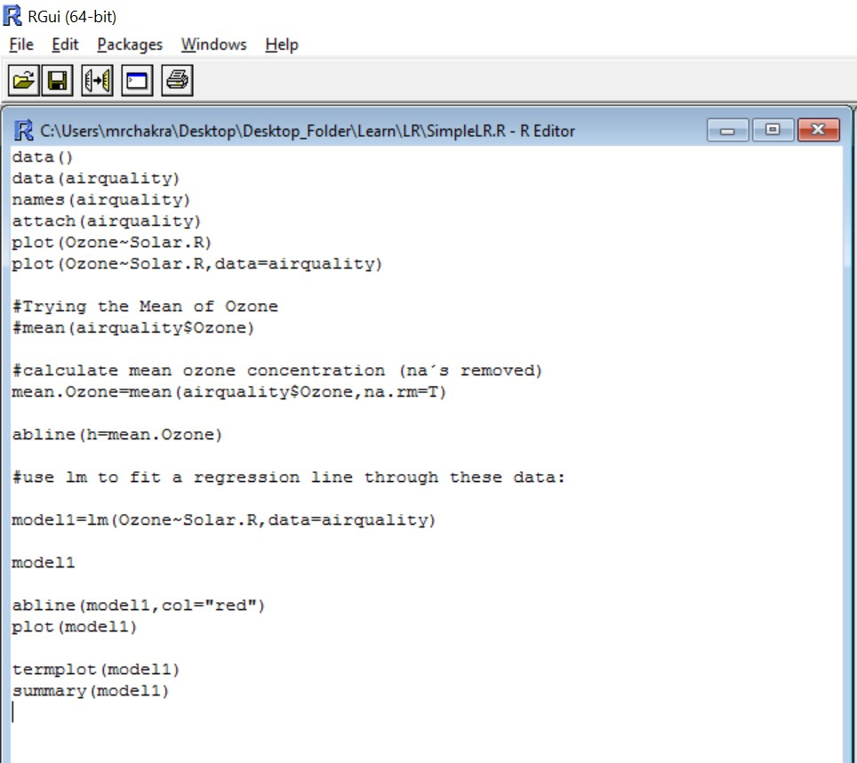

Regression With Code

Slide 41
Thank-You

